Slide 1

Applications and Processing of Metals
Dr. J. Venkatramani
219-B
venkatramani@iiitdm.ac.in

Slide 2
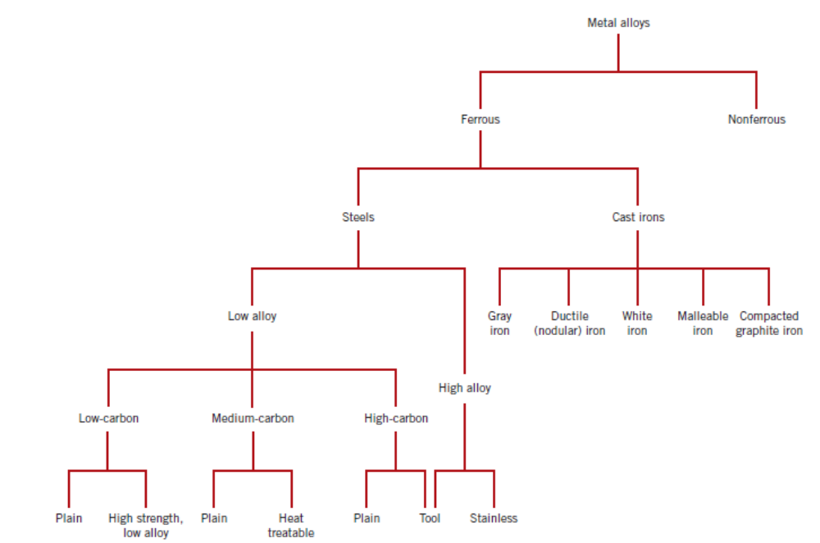
Types of Metal Alloys
Ferrous Alloys
Non–Ferrous Alloys

Slide 3
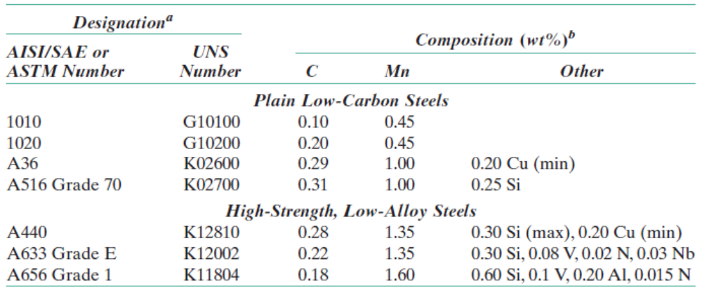
Low Carbon Steels
Low Carbon Steels < 0.25 wt% carbon
  Unresponsive to heat treatments intended to produce martensite
  Strengthening is accomplished by cold work.
  Microstructures consist of ferrite and pearlite constituents. Relatively soft and weak, but ductile. They are also machinable, weldable and are least expensive.
  Applications: automobile parts, structural shapes, sheets used in pipelines, buildings, bridges and tin cans.

Slide 4
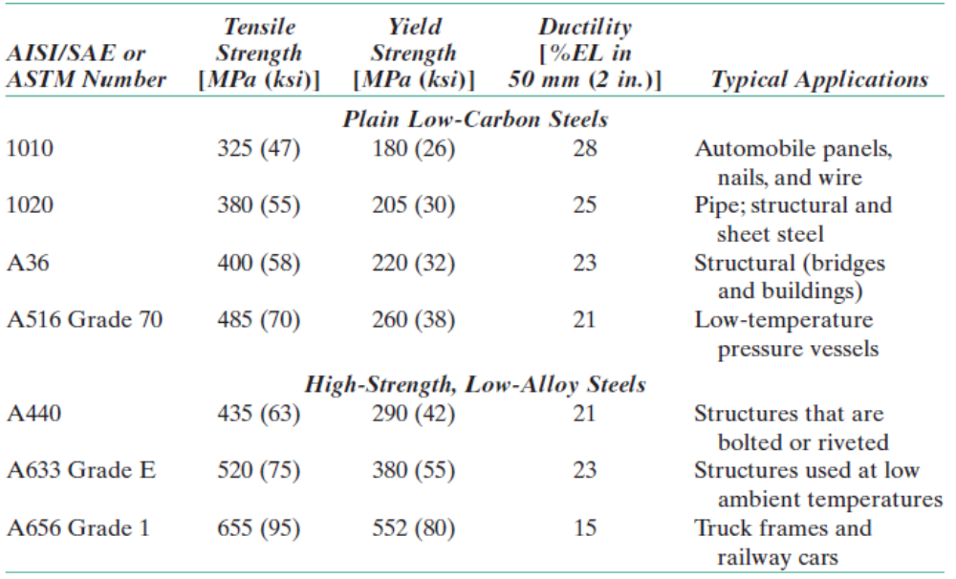
Low Carbon Steels
High Strength low alloy steel (HSLA), machinable, formable, ductile and corrosion resistant.

Slide 5
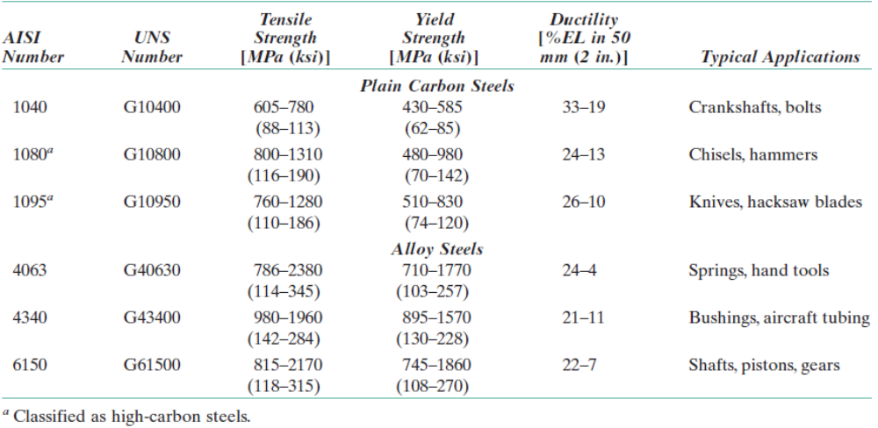
Medium Carbon Steels
0.25 to 0.6 wt% carbon. Austenitizing, quenching and then tempering → microstructures of tempered martensite.
Have low hardenability and can be heat treated in only thin sections of samples with very rapid quenching rates.
Addition of alloying elements improve their capacity to be heat treated. Stronger than the low carbon steels.
Nomenclature: AISI, SAE and ASTM designation – four digit number where first two digits denote the alloy content and the last two digits give the carbon concentration.

Slide 6
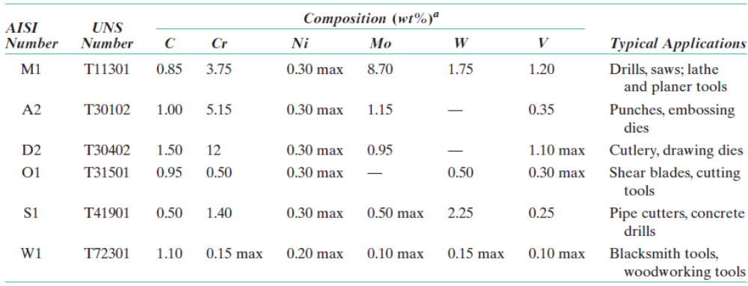
High Carbon Steels
0.6 to 1.4 wt% carbon, hardest, strongest and least ductile. Used in hardened and tempered condition.
Machine Tools, Cutting tools, dies, punches etc., are all made of these steels to have good wear resistance.
Alloying elements are V, Cr, W and Mo.

Slide 7
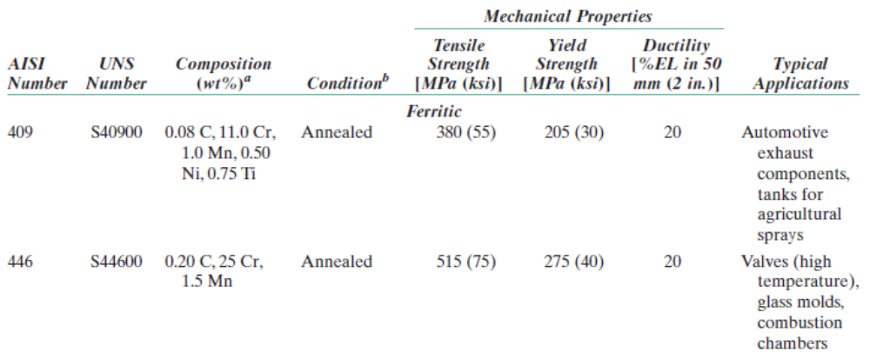
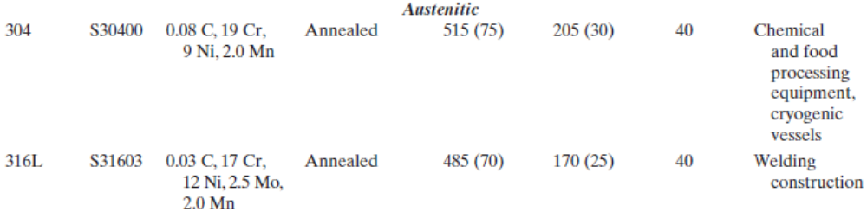
Stainless Steels
Highly resistant to corrosion. 9–11 wt% of Cr is added.
Three types: Martensitic, Ferritic, Austenitic microstructure.
Austenitic and ferritic are cold worked to make them stronger and harder. They are not heat treatable.
Austentic are more corrosion resistant.
Used in high temperature applications like gas turbines, steam boilers.

Slide 8
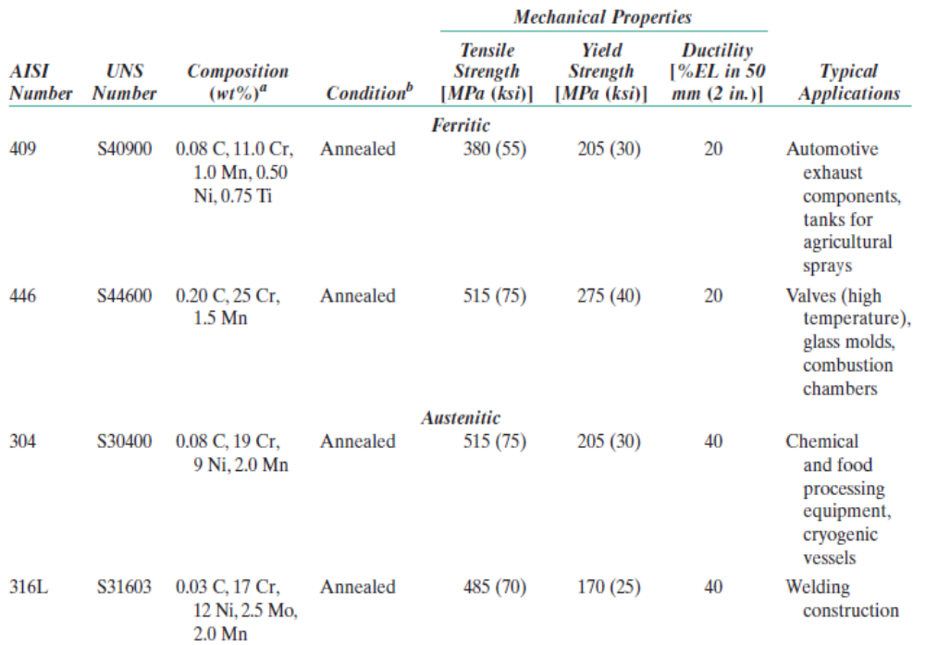
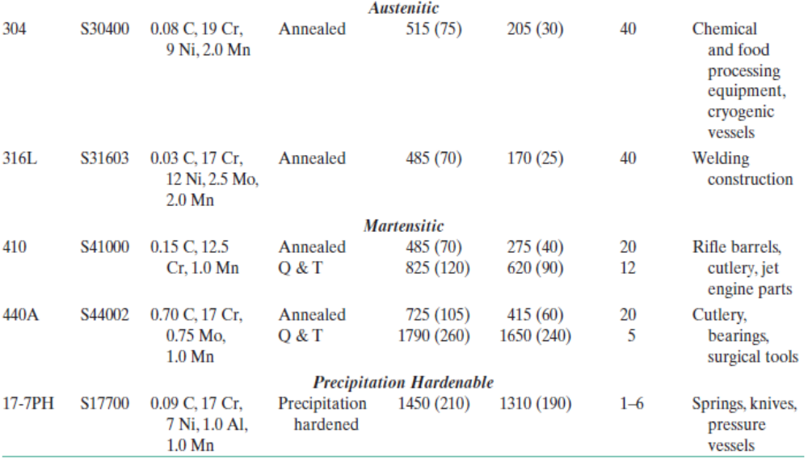
Stainless Steels
Highly resistant to corrosion. 9–11 wt% of Cr is added.
Three types: Martensitic, Ferritic, Austenitic microstructure.
Austenitic and ferritic are cold worked to make them stronger and harder. They are not heat treatable.
Austentic are more corrosion resistant.
Used in high temperature applications like gas turbines, steam boilers.

Slide 9
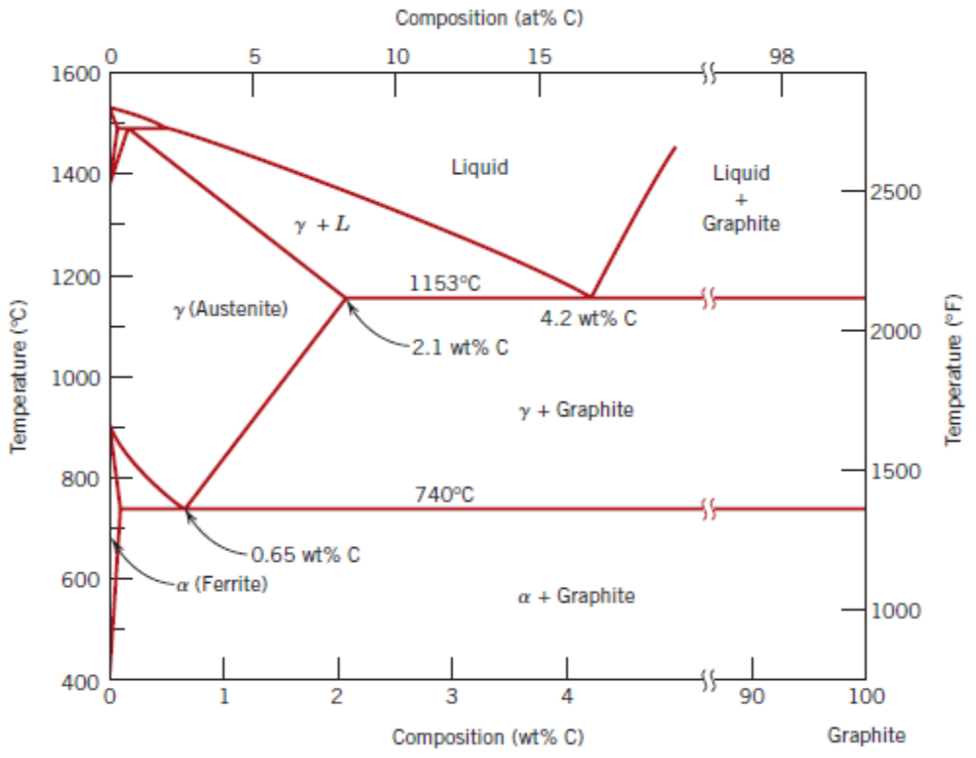
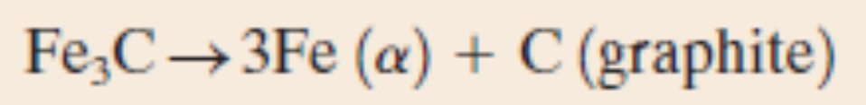
Cast Irons
Carbon content > 2.14% (Austenite phase solubility). Typically 3–4.5 wt% carbon.
Easily melted and amenable to casting.
Cast irons are generally brittle, although it is possible to induce some ductility.
Cementite is a metastable compound.
Slower cooling rates and/ or Si concentrations (of about 1 wt%) favour formation of graphite.

Slide 10
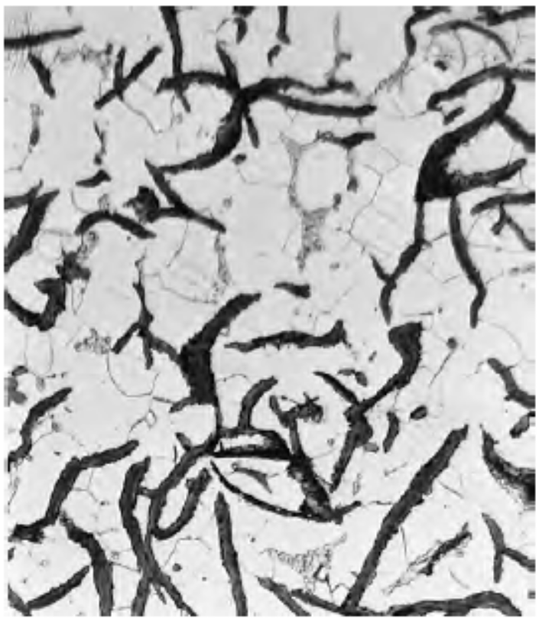
Gray Irons
2.5 to 4 wt% carbon and 1 to 3 wt% Si.
Graphite exists in the form of flakes.
Weak and brittle in tension.
Good at damping vibrational energy. Base to the structures requiring damping are constructed using these materials.
Casting pieces of intricate shapes are possible because of their high fluidity at casting temperature.
Least expensive of all metallic materials.
Flake like graphite structure within ferrite or pearlite phase. Length scale 20 μm.

Slide 11
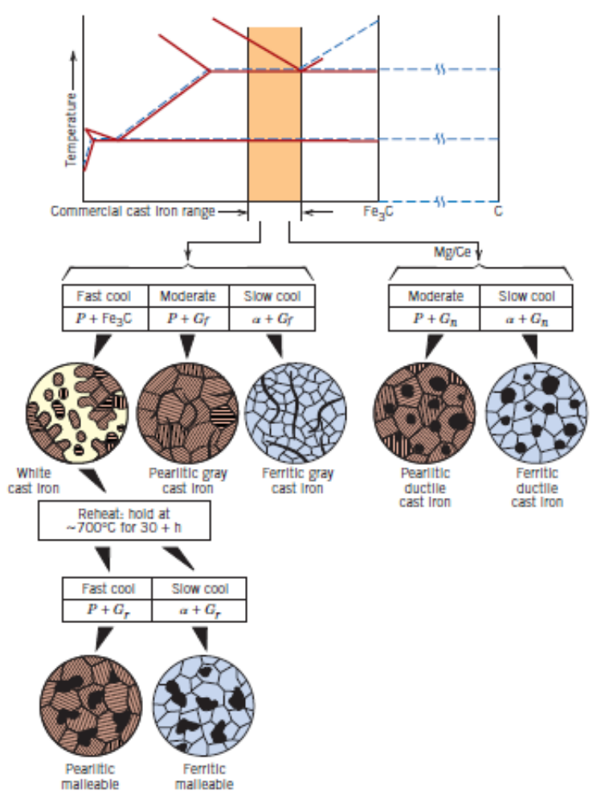
Gray Irons – Other possible microstructres

Slide 12
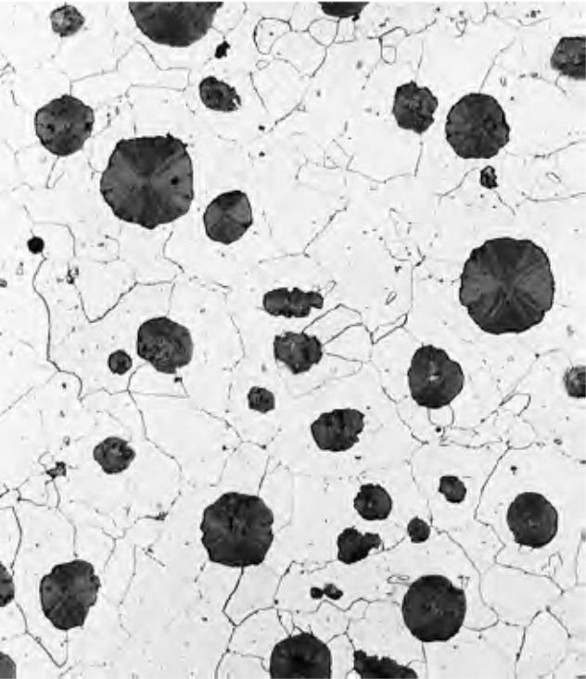
Nodular (Ductile) Irons
Addition of Mg or Cerium to gray cast iron.
Higher yield and tensile strengths compared to gray irons.
Ductility is also higher (10 to 20%).
Valves, pump bodies, crank–shafts, gears etc
Nodular shaped graphite regions within ferrite or pearlite

Slide 13
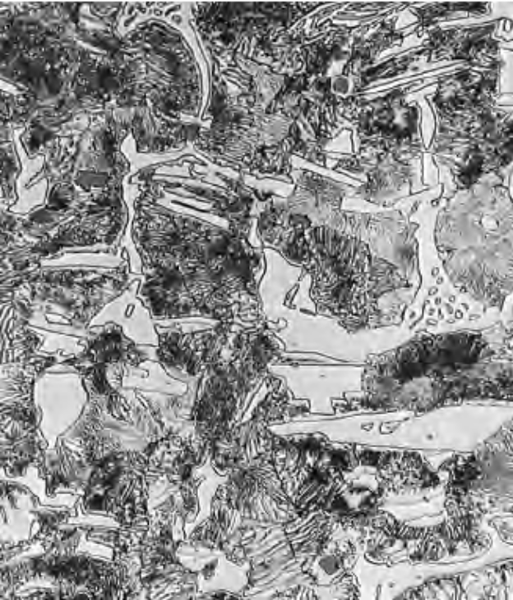
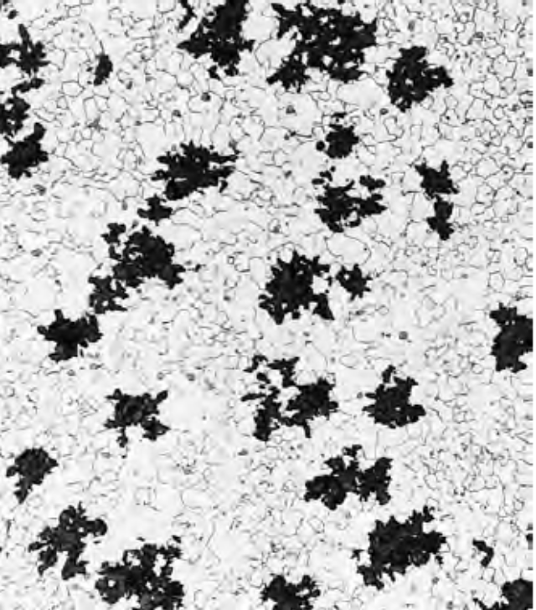
White Iron and Malleable Iron
Si < 1 wt% and rapid cooling rates. Results in white appearance of the fracture surface of this alloy.
Very hard and wear resistant due to presence of large amounts of cementite.
Heat treating white iron at around 800 to 900⁰C in an inert atmosphere results in malleable iron.
Appreciable ductility and malleability.
White cast iron
Malleable iron

Slide 14
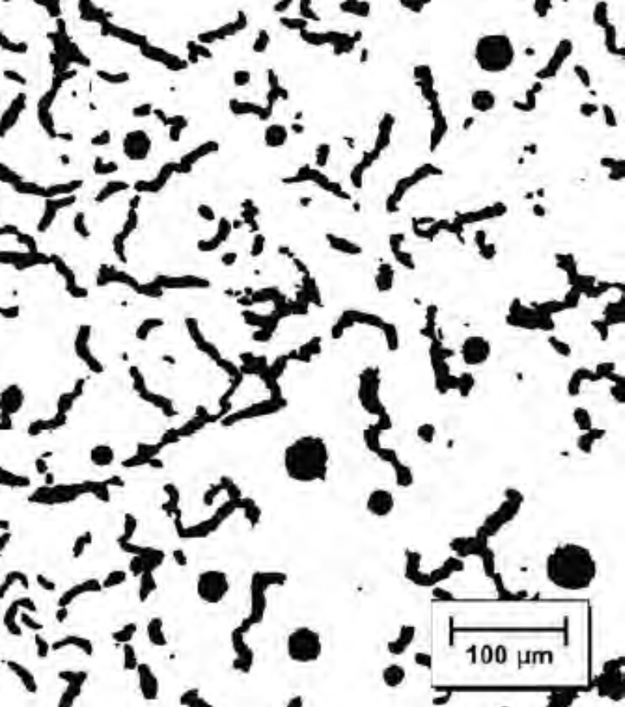
Compacted Graphite Iron
Si content between 1.7 and 3 wt%, while, carbon between 3.1 and 4 wt%.
Higher thermal conductivity better resistance to thermal shock, lower oxidation at elevated temperatures
Applications include diesel engine blocks; exhaust manifolds; gearbox housings; brake discs for high–speed trains and flywheels.
CGI with graphite as both nodules and flakes.

Slide 15
Non–Ferrous Alloys
A few disadvantages of Ferrous alloys: higher density; lower electrical conductivity; susceptibility to corrosion
Two types – Cast alloys and Wrought alloys.
Cu, Al, Mg, Ti, Refractory metals, Superalloys, noble metals and others.

Slide 16
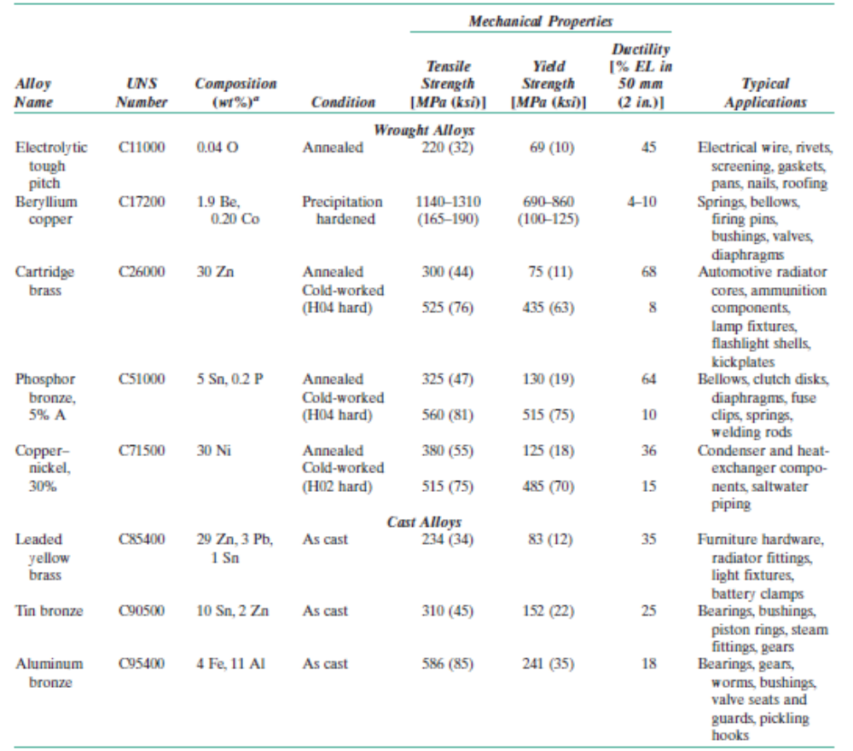
Copper alloys
Unalloyed copper is highly soft and ductile to be machined. Highly suitable for cold working and resistant to corrosion.
Cold working and solid solution strengthening are the ways to strengthen Copper.
Cu – Zn system gives brass alloy, with Zn as solid impurity in Copper.

Slide 17
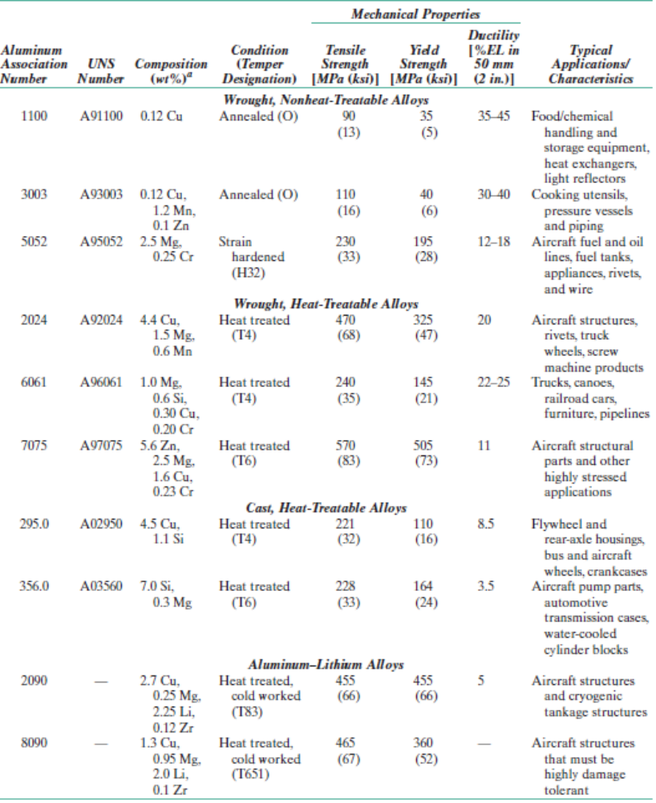
Aluminium alloys
Low density (2.7 g/cc), high electrical and thermal conductivities and good resistance to corrosion.
Easily formable. Ductility retained at even very low temperatures.
Limitation: low melting temperature (660⁰C).
Cu, Mg, Si, Mn, Zn are alloying elements.

Slide 18
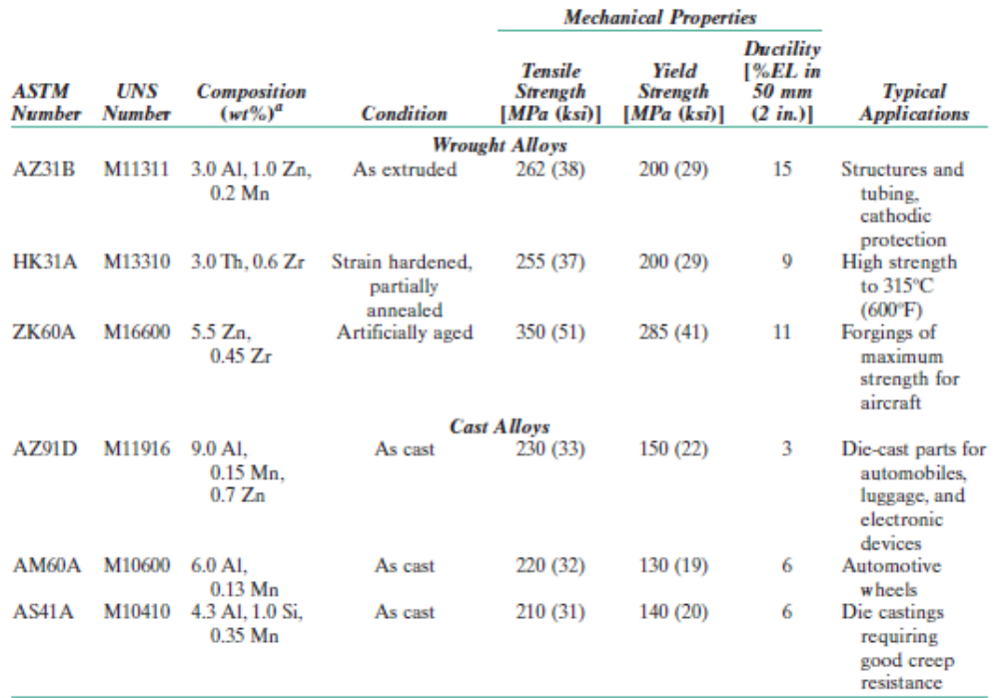
Magnesium and alloys
Density – 1.7 g/cc.
Mg alloys are difficult to deform – mostly they are processed through casting and or hot working processes.
Low melting point: 650⁰C.
Unstable and susceptible to corrosion.
Mg powder ignites easily when heated in air.
Al, Zn, Mn are the major alloying elements.
Recyclable and less expensive to produce – usable as alternative to plastics for weight reduction.

Slide 19
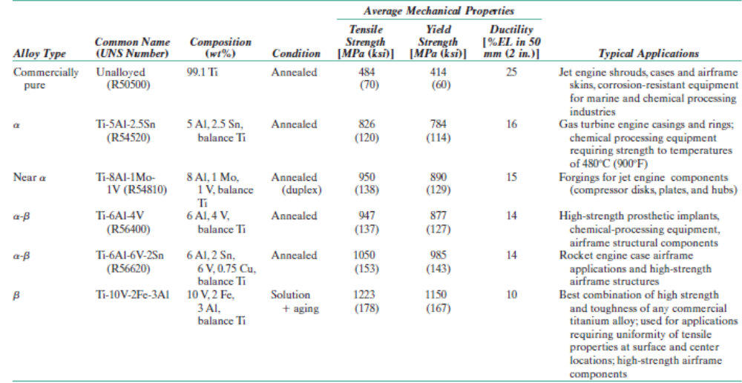
Ti and alloys
Density – 4.5 g/cc.
High melting point: 1668⁰C.
Extremely strong – room temperature yield strength is around 1400 MPa. Highly ductile and easily forged and machined.
Limitation: chemical reactivity at elevated temperatures. Requires nonconventional refining, melting and casting techniques – increasing its production cost.
Corrosion resistance is also very good.
Commonly utilized in airplane structures.

Slide 20
Refractory Metals and Superalloys
Refractory Metals
Extremely high melting point – Nb, Mo, W, Ta with melting temperatures ranging from 2468⁰C to 3410⁰C.
Ta and Mo are alloyed with stainless steels to improve corrosion resistance.
Superalloys
Superlative combinations of properties, used in aircraft turbine components.
Example: Inconel 718 – Austentic Ni and Cr based superalloy. Other possible base metals can be Iron and Cobalt.
Other alloying elements are Nb, Mo, W, Ta and Ti.

Slide 21
Noble metals and Other Miscellaneous non–alloys
Expensive, soft, ductile and oxidation resistant – silver, gold, platinum, palladium, rhodium, ruthenium, iridium and osmium.
Ni based alloy – Monel used for pumps, valves and other components which are prone to corrosion. Contains 65 wt% Ni, 28 wt% Cu and the rest iron.
Lead, Tin and their alloys also have usage in soldering applications as their melting temperatures are lower and corrosion resistance is good.
Tin coating on the inside of steel food containers for inhibiting any reactions between the steel and the food.
Unalloyed Zn is highly susceptible to corrosion. It is added as a sacrificial layer on plain carbon steel – Galvanization.
Zr is used as cladding for uranium fuel in water–cooled nuclear reactors.

Slide 22
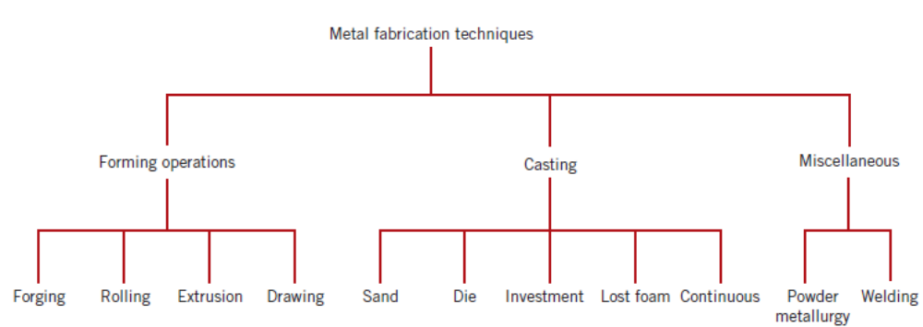
Fabrication of Metals

Slide 23
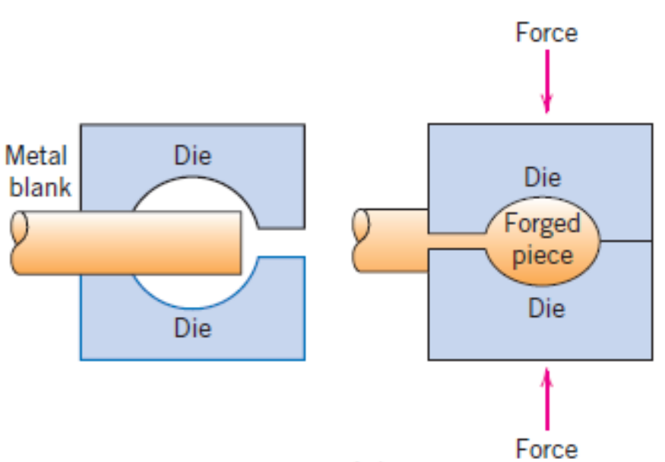
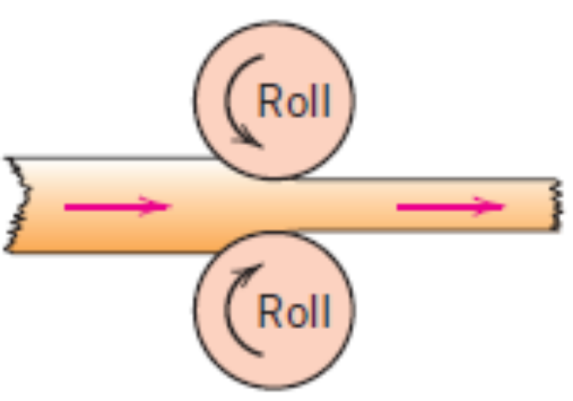
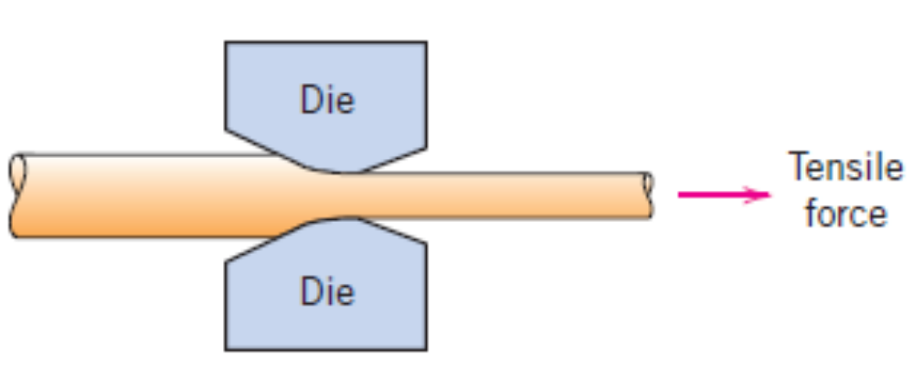
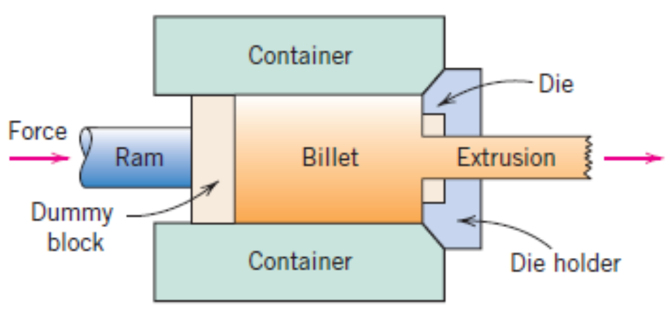
Forming operations
Rolling
Forging
Drawing
Extrusion

Slide 24
Thermal Processing of Metals
Annealing
Material is exposed to elevated temperatures for extended periods and then cooled down slowly. Required to (1) Relieve stresses (2) Induce ductility and toughness (3) form a specific microstructure.
Three stages – (1) heating to a desired temperature (2) holding or “soaking” (3) cooling to room temperature
  Process annealing – to negate the effects of cold working. Recovery and recrystallization happens.
  Stress relief – to relieve the stresses caused by machining, grinding, heat treatment, non–uniform cooling.

Slide 25
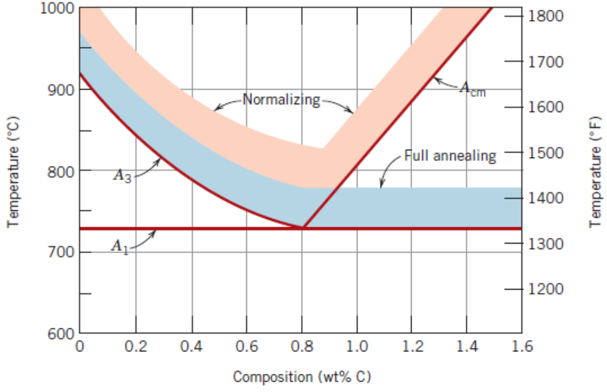
Thermal Processing of Metals
Annealing of ferrous alloys
Normalizing – performed to refine the elongated grains obtained after rolling like plastic deformation processes. Air cooled thereafter. Fine pearlite is formed.
Full annealing done in low and medium carbon steels which experience severe plastic deformation during machining operations. Heated above A₃ for compositions less than Eutectoid and above A₁ for compositions more than Eutectoid. Furnace cooled thereafter. Coarse pearlite is formed.

Slide 26
Thermal Processing of Metals
Annealing of ferrous alloys
Spheroidizing – performed on medium and high carbon steels to induce ductility and softness. Cold working enhances the spheroidizing rate.

Slide 27
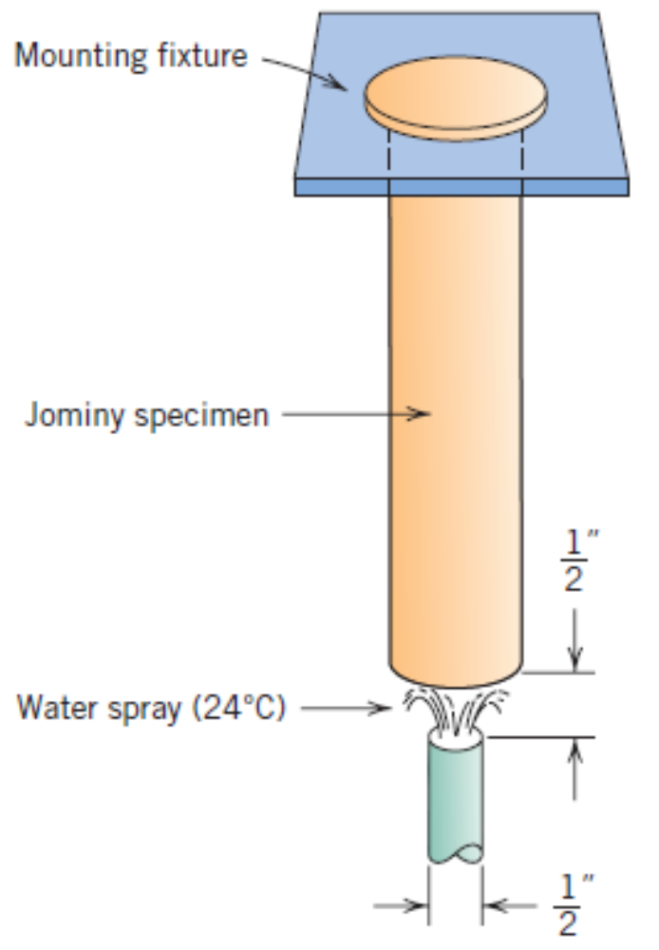
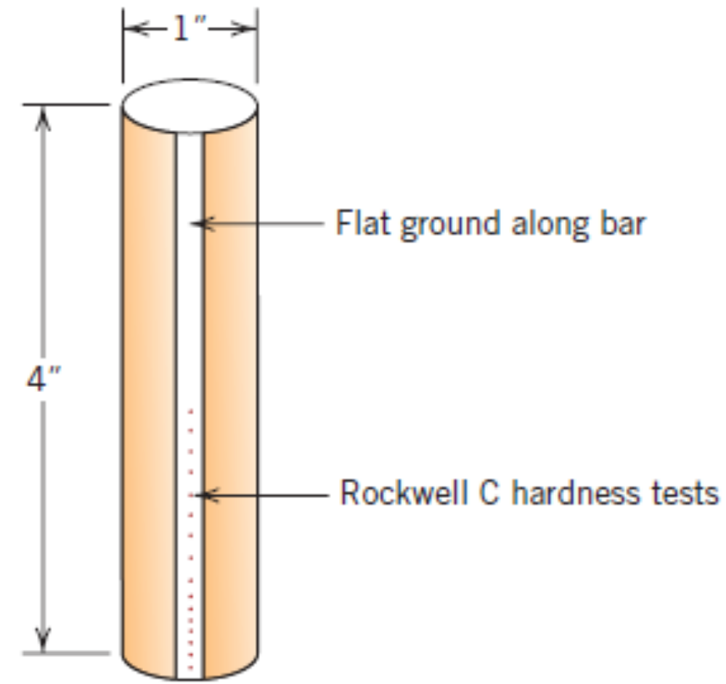
Heat Treatment of Steels
Martensitic Transformation and Hardenability:
Hardenability indicates the influence of alloy composition on the tendency of a steel alloy to undergo martensitic transformation. A qualitative measure of ability to form martensite deeper into the material.
Should NOT be confused with the hardness of a material.
Jominy End – Quench Test:

Slide 28
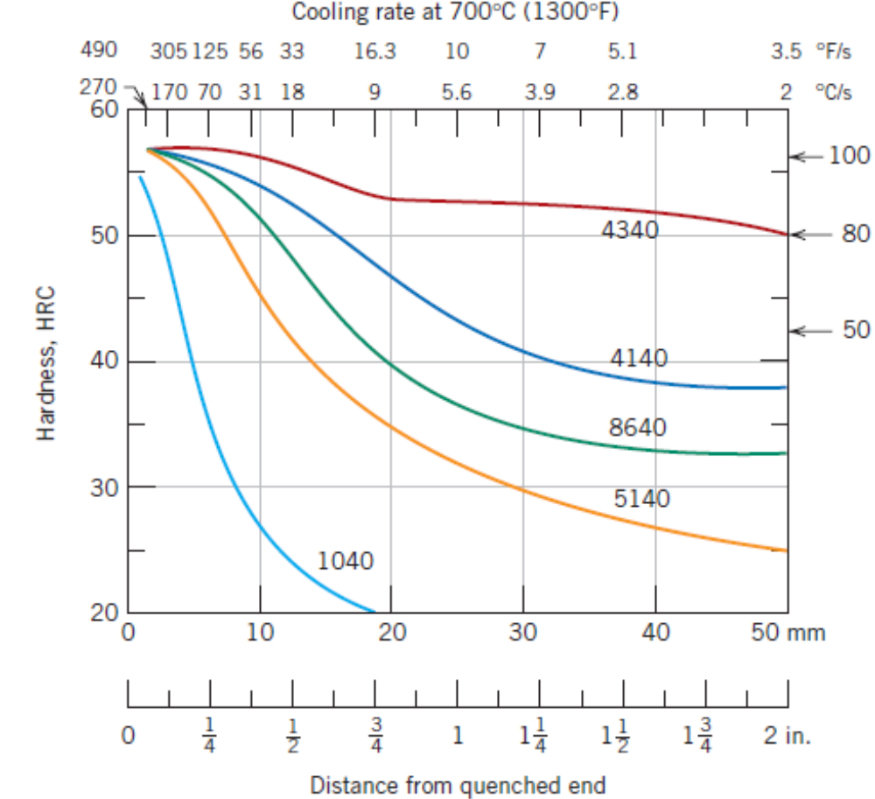
Heat Treatment of Steels
Factors influencing the hardenability of an alloy
Alloy composition
Cooling rate
Quenching medium
Specimen Size
Geometry

Slide 29
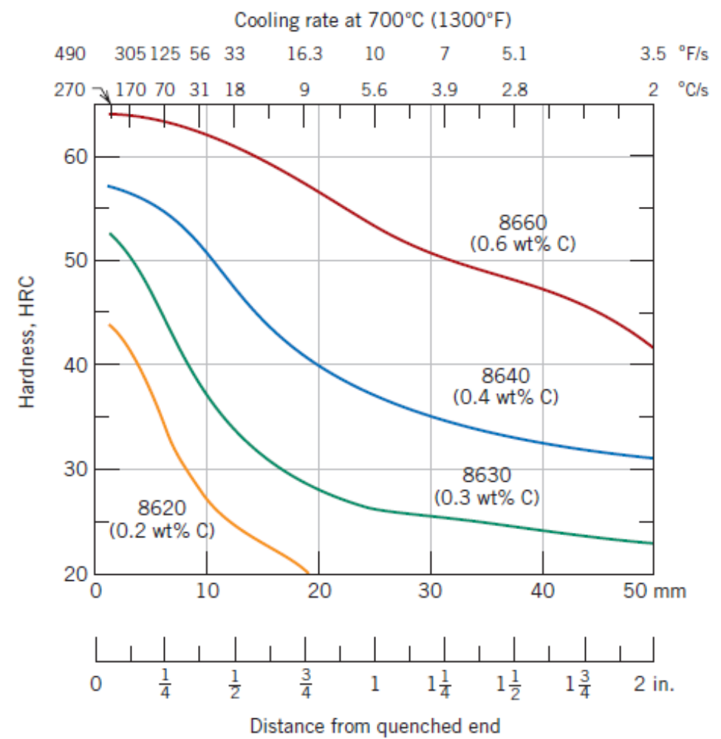
Heat Treatment of Steels
Factors influencing the hardenability of an alloy
Alloy composition
Cooling rate
Quenching medium
Specimen Size
Geometry

Slide 30
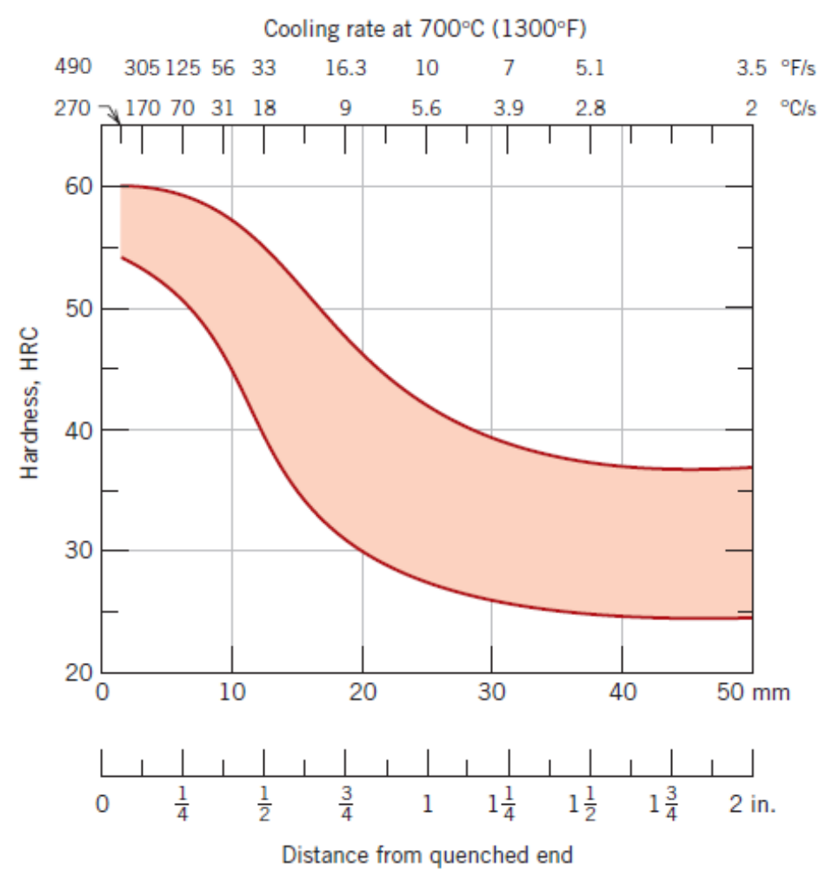
Heat Treatment of Steels
Factors influencing the hardenability of an alloy
Alloy composition
Cooling rate
Quenching medium
Specimen Size
Geometry
Hardenability band for 8620 steel

Slide 31
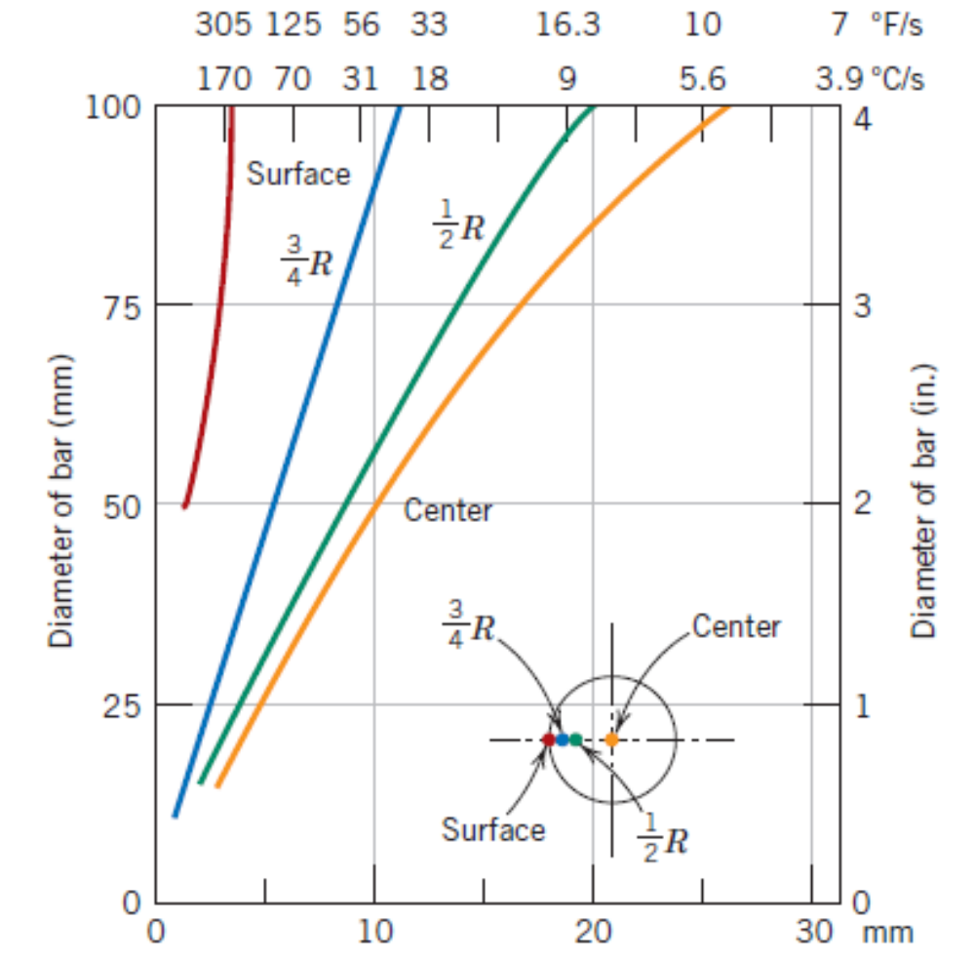
Heat Treatment of Steels
Factors influencing the hardenability of an alloy
Alloy composition
Cooling rate
Quenching medium
Specimen Size
Geometry
Water as the quench medium

Slide 32
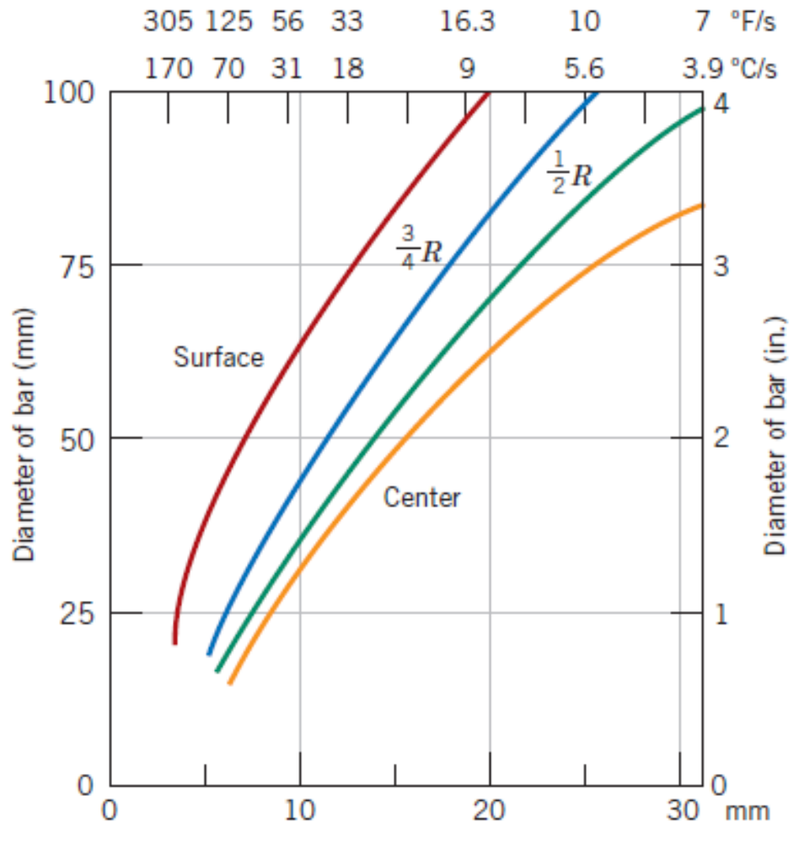
Heat Treatment of Steels
Factors influencing the hardenability of an alloy
Alloy composition
Cooling rate
Quenching medium
Specimen Size
Geometry
Oil as the quench medium

